Slide 1


Slide 2











































Our Mission is Protection. Our Focus is You.
And many, many more! We work with over 200 companies.

Slide 3
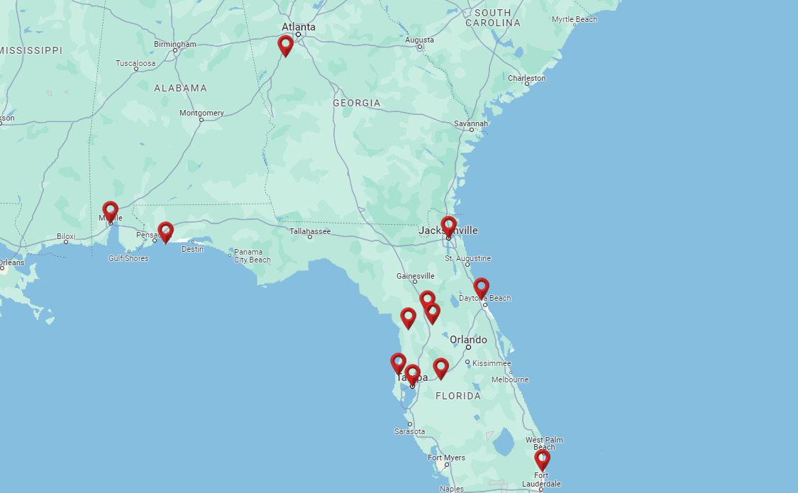
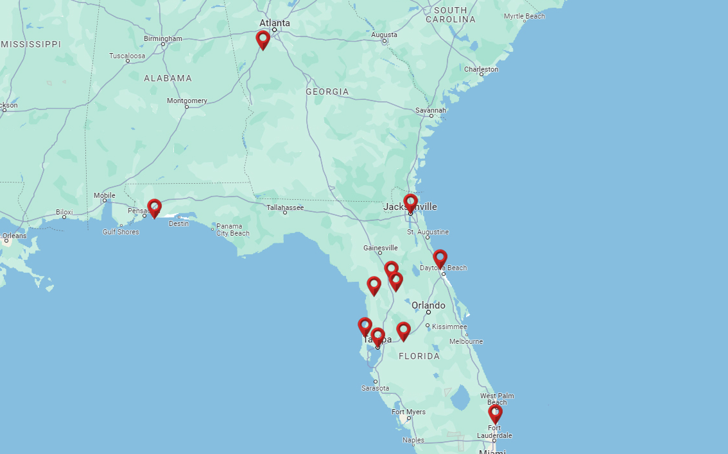

11 Offices & Growing
200+ Licensed Professionals
Full Service Staff
Boca Raton, FL
Gulf Breeze, FL
Jacksonville, FL
Lakeland, FL
Lecanto, FL
Ocala, FL
Ormond Beach, FL
Tampa, FL
Tarpon Springs, FL
The Villages, FL
Peachtree City, GA

Slide 4

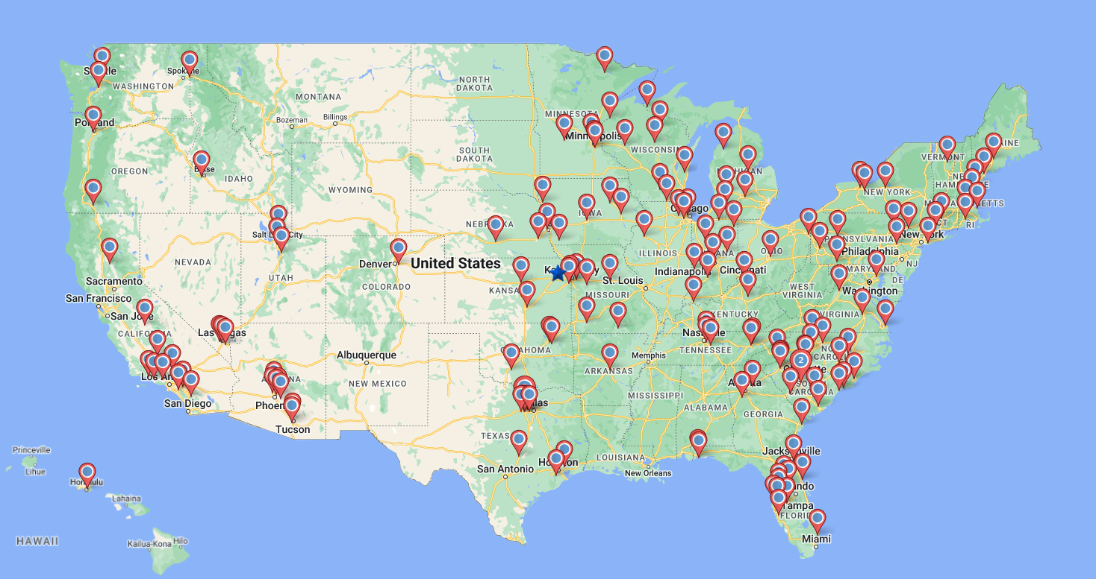








150+ Offices in
43 States means we have an agent who can help you anywhere you go!
Endorsed By:

Slide 5

Our Mission Statement
“To leave our client’s home better off than when we got there.
In order to achieve this and to successfully pursue our mission, we choose to work with highly trained, professional and ethical associates and companies.”

Slide 6





Medical Bills
There are 4 major concerns that keep retirees up at night.
Independence /
Post-Hospital Care
Legacy
Out-Living
Your Money

Slide 7
Your Medicare Options
START
      Decide How to Get Your Coverage
Original Medicare
+
Medicare Supplement
+
Prescription Drug Plan
Medicare Advantage
Part C
(HMO or PPO)
(Combines Parts A, B & D)
Includes;
No Network
Limits Out-of-Pocket Costs
Monthly Premiums
No Added Benefits
Includes;
Dr. & Hospital Networks
Co-Pays & Deductibles
No Monthly Premiums
Possible Added Benefits
Ask How to Cover Co-Pays & Deductibles!

Slide 8
Medicare Supplement (Medigap) Plans
Benefits | A | B | C * | D | F * | G | K | L | M | N
Medicare Part A coinsurance and hospital costs (up to an additional 365 days after Medicare benefits used) | 100% | 100% | 100% | 100% | 100% | 100% | 100% | 100% | 100% | 100%
Medicare Part B coinsurance or copayment | 100% | 100% | 100% | 100% | 100% | 100% | 50% | 75% | 100% | 100%**
Blood (first 3 pints) | 100% | 100% | 100% | 100% | 100% | 100% | 50% | 75% | 100% | 100%
Part A hospice care coinsurance or copayment | 100% | 100% | 100% | 100% | 100% | 100% | 50% | 75% | 100% | 100%
Skilled nursing facility care coinsurance |  |  | 100% | 100% | 100% | 100% | 50% | 75% | 100% | 100%
Part A deductible |  | 100% | 100% | 100% | 100% | 100% | 50% | 75% | 50% | 100%
Part B deductible |  |  | 100% |  | 100%
Part B excess charges |  |  |  |  | 100% | 100%
Foreign Travel Emergency (up to plan limits) |  |  | 80% | 80% | 80% | 80% |  |  | 80% | 80%
*Plans C and F only available if Part A was effective prior to 01/01/2020.
**Plan N Part B coinsurance includes small copayment for office visits and emergency room visits.
Out of pocket limits apply

Slide 9

Independence / Post-Hospital Care
7 in 10 seniors will need some type of extended care in their lives.
The average length of extended care is 3 years.
www.longtermcare.gov
    National Average Cost of Care in 2023
    Home Health Aide $6,292 per month
    Assisted Living $5,350 per month
    Nursing Home (Private Room) $9,733 per month
    www.genworth.com/costofcare
    How will you pay for your care?
    Self-Insure
    Hybrid Policy
    Insurance Policy
    Medicaid (Spend-down w/ limited options)

Slide 10
Life Insurance Policy Review
    Do you know where your policy is?
    When was the last time your policy was reviewed?
    Are your beneficiaries correct?
  Do your beneficiaries know about the life insurance you currently have? If a claim is not filed after your death, no benefits will be paid.
        Are you still paying premiums? Some older policies can be set up to pay for themselves.
  Some life insurance policies can be outdated in their structure or pricing. Could you be paying too much? Do you have enough coverage?
  How much cash value do you have and what is the best way to utilize it?

Slide 11



What is Your Risk Tolerance?
Our 11 question money risk analysis gives you a deeper understanding of your overall risk preferences.
Our Color of Money report is a powerful tool to help you prepare for the retirement you’ve always wanted.
Build confidence
in your retirement.
FINANCIAL OVERVIEW
RETIREMENT COMPASS
SOCIAL SECURITY MAXIMIZATION

Slide 12
The Triple-Compounding Effect
No Market Risk
Tax Deferred
Probate-Proof
Recession-Proof
Protect Against Creditors
INTEREST ON TAX DEFERRAL
INTEREST ON INTEREST
INTEREST ON PRINCIPAL
P R I N C I P A L

Slide 13
Fixed Indexed Annuity vs. S&P 500
$100,000 Invested Over 10 Years
Fixed Indexed Annuity* S&P 500**
*Based on 1 Yr S&P Pt-to-Pt w/ 8% Cap **Yahoo Finance Historical Data
Annuities are long-term insurance products primarily designed to provide retirement income. Guarantees are backed by the financial strength and claims-paying ability of the issuing insurance company. Early withdrawals may impact annuity cash values and death benefits. Annuities are not guaranteed by FDIC or any other governmental agency.

Slide 14




By planning your retirement and insurance needs through an American Senior Benefits agent, you will have access to Tuition Rewards™, a unique scholarship program.
HOW TO EARN TUITION POINTS
  ANNUITIES
  MEDICARE SUPPLEMENTS
  MEDICARE ADVANTAGE
  LONG TERM CARE & ASSI
  CASH VALUE LIFE INSURANCE
  BONUS POINTS!
    INITIAL REGISTRATION
    ANNUAL REVIEW
    REFER UP TO 5 LOVED ONES!
    See official materials for details.
When your registered loved one attends one of nearly 500 participating private colleges, you will get to use your points to reduce their tuition by as much as 25% per year. Remaining credits can be used by another registered loved one.
Tuition Rewards
Making dreams come true

